Slide 2
Oral Statements
Oral statements or discussion during the pre-bid meeting today will not be binding, nor will it change or affect the terms or conditions within the Plans and Specifications of this Project. Changes, if any, will be addressed in writing only via an Addendum.

Slide 3
Agenda
General Information
Small, Minority, Women and Veteran-Owned Business (SMWVB Requirements)
Contract Requirements
Bid Packet Preparation
Addendums
Vendor Registration
Bid Opening Dates/Time
Technical Information

Slide 4
General Information
Non-Mandatory pre-bid meeting
Presentation and the attendance sheet will be posted to the SAWS website
Construction services being procured through low bid under Government Code 2269
A Geotechnical Data Report, Invertebrate Technical Report and Preliminary Environmental Assessment are accessible and available to potential Bidders on the SAWS website upon signing a disclaimer form

Slide 5
General Information
Estimate: $2,465,610.00
Calendar days:
365 calendar days

Slide 6
Aspirational SMWB Goal
Industry | Aspirational SMWB Goal
Construction | 20%
The aspirational SMWB goal is 20% of your total bid price.
Notes:
Contracting

Slide 7
Accepted SMWVB Certification Agency
South Central Texas Regional Certification Agency
  MBE, WBE, SBE (Includes “HUB” Program)
Minimum Qualifications for SMWVB recognition:
SBE-Certified (even MBEs and WBEs)
Local office or local equipment yard

Slide 8
Good Faith Effort Plan (GFEP) FAQs
Q: Is the 20% SMWB goal mandatory?
A: No, but we ask prime contractors to do their best with good faith outreach efforts. If the goal is not met, proof of outreach efforts is required with the submittal.
Q: What if I am having trouble finding SMWB subcontractors?
A: Please email the SMWVB Program Manager with the scopes of work you are seeking. You will receive lists of local SMWVB-certified firms to contact.
Q: What if my business is SMWB-certified? Do I need to find SMWB subs?
A: If your firm is SMWVB-certified, you will most likely meet the goal. However, the GFEP is a required document, and a good faith outreach effort is still necessary.
Q: Do I need to include all my subcontractors in the GFEP or just those that qualify towards the
SMWB goal?
A: All subcontractors need to be included in the GFEP, even those that may not count towards the SMWB goal.
Q: What if I have questions about the GFEP?
A: Please contact the SMWVB Program Manager at 210-233-3420, or at Marisol.Robles@saws.org . GFEP questions can be asked at any time before the submittal is due.
Notes:
SMWB

Slide 9
Post Award: Subcontractor Payment & Utilization Reporting (S.P.U.R.) System
1. Subcontractor & Supplier Payment Tracking
2. Subcontractor and Supplier Additions or Substitutions
3. LCP Tracker
4. Must be Current and Accurate before Retainage is released https://saws.smwbe.com

Slide 10
Contract Requirements
Prevailing Wage Rate and Labor Standards – Section 2.10 of the General Conditions
Certified payroll to be submitted on weekly basis
Wage decisions are included within the specifications
Contractors to utilize LCP Tracker
Site visits are random and unannounced
Interviews will be Conducted and will be private & confidential
Payroll records are subject to review
All apprenticeship programs will need to be approved by Department of Labor prior to starting
Contractors are responsible for sub-contractor payroll
Late payrolls delay contractor payments from SAWS

Slide 11
Contract Requirements
Insurance requirements are found in Section 5.7 of the GCs
  Installation Floater coverage is required in lieu of Builder’s Risk
Contractor shall maintain insurance coverage during the construction of this Project
Insurance must be compliant prior to executing the contract
SAWS will ask for insurance prior to Board award to expedite execution of the contract
  Any deficiencies must be corrected prior to Board award

Slide 12
Bid Packet Preparation
Utilize the Bid Packet Checklist within the specifications
Double check all mathematical calculations and verify all extensions
Ensure Mobilization & Prep ROW Line Item does not exceed the percentage allowed
Statement of Bidder’s Experience forms are required
  Similar projects should match the scope/experience indicated on the SBE form
  References and contact information must be verified prior to submitting
Addendums are acknowledged on the Bid Proposal Signature Page
A baseline schedule will be required by the apparent low bidder only with an assumed Notice to Proceed Date of November 23, 2020

Slide 13
Addendum(s)
Revisions, Clarifications, Questions and Answers (Q&A’s)
Question deadline is September 22, 2020 by 10:00 A.M.
Addendum will be posted on SAWS’ website on September 25, 2020 by 3:00 P.M.
All questions should be sent in writing via email or fax.
Check the SAWS website regularly for addendum postings.
It is possible to have multiple addendums during the time frame in addition to the scheduled final addendum.

Slide 14
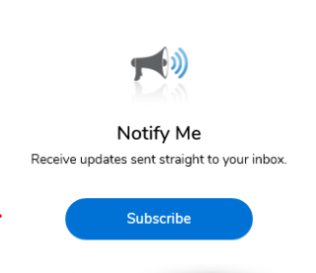
Vendor Registration & Notification (VRN)
Please register through SAWS’ Vendor Registration Program on the SAWS website at www.saws.org to ensure access to the latest information.
To receive updates on specific projects, registered vendors must ‘Subscribe’ to the project by selecting the project, and clicking ‘Subscribe’ under the Notify Me box.
https://apps.saws.org/Business_Center/Contractsol/

Slide 15
Bid Opening Dates/Times
October 2, 2020 at 3:00 PM
Bids will be received either electronically or sealed bids.
Electronic bids will be received via the secure SAWS FTP site.
Request to submit the bid electronically through SAWS FTP site must be submitted no later than 3:00 p.m. October 1.
Bids may not be late
  Late bids will not be accepted and will be returned unopened
Sealed bids will be received by Contract Administration, 2800 U.S. Hwy 281 North, Tower II, Customer Service Building, via a drop box located on the left wall when walking through the first set of double glass doors of the main Tower II entry on the north side of the building.
  If delivering in person to SAWS, Bidders should allow sufficient travel time.

Slide 16
Project Background
Bid for construction is for a specified contract with rehabilitation of 11,040 linear feet of 8”-21” sanitary sewer mains by cured in place pipe.
Project is part of the EPA Consent Decree. See Special Conditions for additional information on these requirements.
Contractor is to become familiar with the plans, locations, and specifications.
Notes:
SAWS PE slides

Slide 17
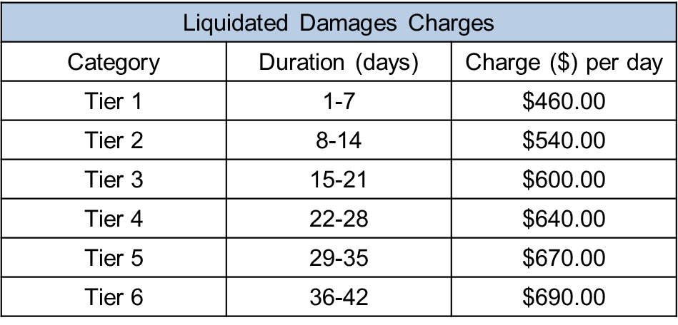
Contract Requirements
Supplemental Conditions
Contractor shall perform the work with its own organization on at least 40% of the total original contract price which should be indicated on the Good Faith Effort Plan.
Bidder is required to submit Statement of Bidders Experience as part of their bid.
Liquidated damages will be assessed as follows for final completion extending beyond contract time:
Any days tallied after 42 days will be assessed as a Tier 6 rate.

Slide 18
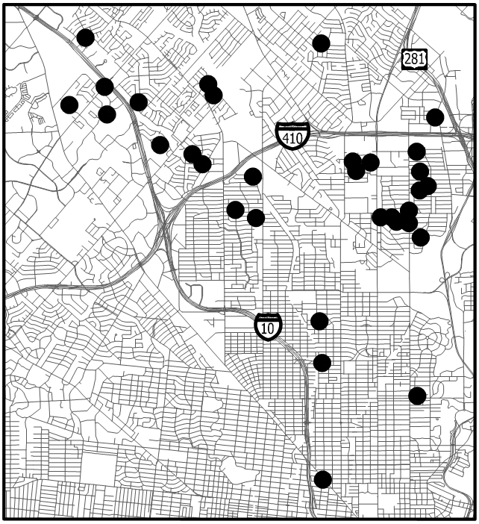
Project Background
36 Project Locations
CoSA ROW
  Approx. 8,917of 8-inch, 10-inch, 12-inch,
  15-inch, and 21-inch
TxDOT ROW
  Approx. 178 LF of 8-inch
Private Property
  Approx. 1,945 of 8-inch and 12-inch
Notes:
SAWS PE slides

Slide 19
Special Conditions
Contractor to submit a completion report when the report is complete
  Pre and post MPEG – 1 video and video logs
  Any tests and/or submittals specified in the Contract Documents
Special Coordination Requirements
  School District Coordination
    Contractor’s baseline schedule shall incorporate schedules for schools located within the project limits. Contractor to perform the work during weekends, holidays, or scheduled school breaks to avoid construction and traffic control during periods of school
  Apartment Complex Coordination
    Multiple project limits are located within or near apartment complexes. Contractor to coordinate with apartment complex property managers prior to construction
  CPS Energy
    Contractor to begin coordination immediately after Notice to Proceed is provided by SAWS to avoid construction delay
    Pole bracing shall be paid as an allowance and poles anticipated for bracing have been identified on the plans. Contractors to bid accordingly.
Notes:
SAWS PE slides

Slide 20
Special Conditions
Special Coordination Requirements
  CoSA
    Contractor shall obtain right-of-way (ROW) permits, and conform to the CoSA requirements for impacted streets along with any other pertinent items located within CoSA ROW
  TxDOT
    SAWS will obtain TxDOT permits for project locations within TxDOT ROW (Wurzbach)
    Contractor shall coordinate with TxDOT inspectors to ensure all work is in accordance with the TxDOT permit guidelines
  VIA Metropolitan Transit
    Contractor must notify VIA dispatch and Mark Spaulding a minimum of 48-hours prior to commencing any work that requires temporary closures at bus stops
Notes:
SAWS PE slides

Slide 21
Special Conditions
Right-of-Entry and Access
  Multiple sites pending ROE coordination and access
    Contractor shall prioritize all other sites and schedule sites with pending ROE coordination and access. These segments are to be constructed at the end of the project after confirming ROE has been acquired by SAWS
  C-110 Compkey 963777 Datapoint Dr.
    Construction is currently ongoing at 38Thirty Property north of project area.
    Contractor to coordinate with contractor and developer prior to CIPP operations at this project site
Notes:
SAWS PE slides

Slide 22
Special Provisions to Technical Specifications
Item 865 Bypass Pumping (Small Diameter Sanitary Sewers)
  Measurement and Payment is “Per Each” Project Location
  Measurement of the work for burying bypass piping, installing flowable fill, temporary pavement, removing buried bypass piping and flowable fill, permanent flowable fill, pavement restoration (including striping) shall be incidental to the work and will not be paid separately
Item 530 Barricades, Signs, and Traffic Handling
  Measurement and Payment is “Per Each” Project Location
  Measurement of the work for providing, installing, moving, repairing, maintaining, cleaning, and removing all barricades, signs, cones, lights, and other such devises and handling traffic shall be incidental to the work and will not be paid separately
Notes:
SAWS PE slides

Slide 23
Special Specifications
Item SS 1 – Wood Privacy Fence
  Encompasses removal and replacement of wood privacy fence (6’ height)
Item 3300 – Sanitary Sewer Private Lateral (4”-6”) (Including COSA Permit and Licensed Plumber)
  To be used for 4” and 6” lateral installation and adjustment within private property
Notes:
SAWS PE slides

Slide 24
Key Dates
Date | Action
WebEx Non-Mandatory pre-bid | Wednesday, September 16, 2020 at 2:00 PM
Questions Due | Tuesday, September 22, 2020 by 10:00 AM
Addendum Posted | Friday, September 25, 2020 by 3:00 PM
FTP Request | Thursday, October 1, 2020 by 3:00 PM
WebEx Bid Opening | Friday, October 2, 2020 at 3:00 PM

Slide 25
Contact Information
Contact Name | Title | Telephone Number | Email address
Roxanne Lockhart | Contract Administrator | 210-233-3095 | Roxanne.Lockhart@saws.org
Marisol Robles | SMWVB Program Manager | 210-233-3420 | Marisol.Robles@saws.org
REMINDER
Please be advised that Bidders are prohibited from communicating with any other SAWS staff, the Consultant, the Developer, or City of San Antonio officials regarding this IFB up until the contract is awarded as outlined in the Instructions to Bidders

Slide 26

QUESTIONS
Reminder: Oral statements or discussion during the pre-bid meeting today will not be binding, nor will it change or affect the terms or conditions within the Plans and Specifications of this Project. Changes, if any, will be addressed in writing only via an Addendum.

